Slide 1



Plan C
Not labeled studios
This presentation and game has depictions of heavy topics

Slide 2
Overview
Singleplayer
First person view
Interactive fiction, Mystery, Puzzle, psychological horror
Linux and Windows PC, web browser

Slide 3
Gameplay
Dialogue intensive
Non-linear story
Choices matter
Puzzle solving
Escape room experience

Slide 4
Story
Waking up, you find yourself trapped in a room with an unfamiliar woman
Your captor appears on a monitor and offers you freedom if you complete their challenges, if not, you are punished
Somehow all of them are connected with the famous Snatch company

Slide 5
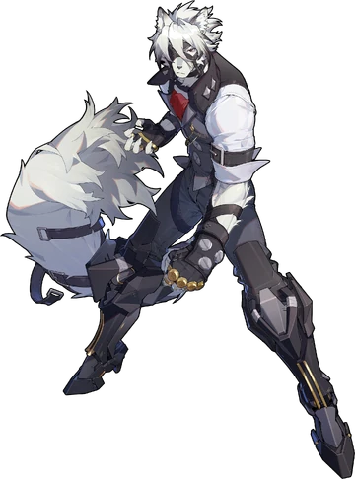
Character - Detective (player)
In his mid 40s
Investigating the “Snatch” company
Well dressed but unkempt
High sense of morals
Workaholic

Slide 6
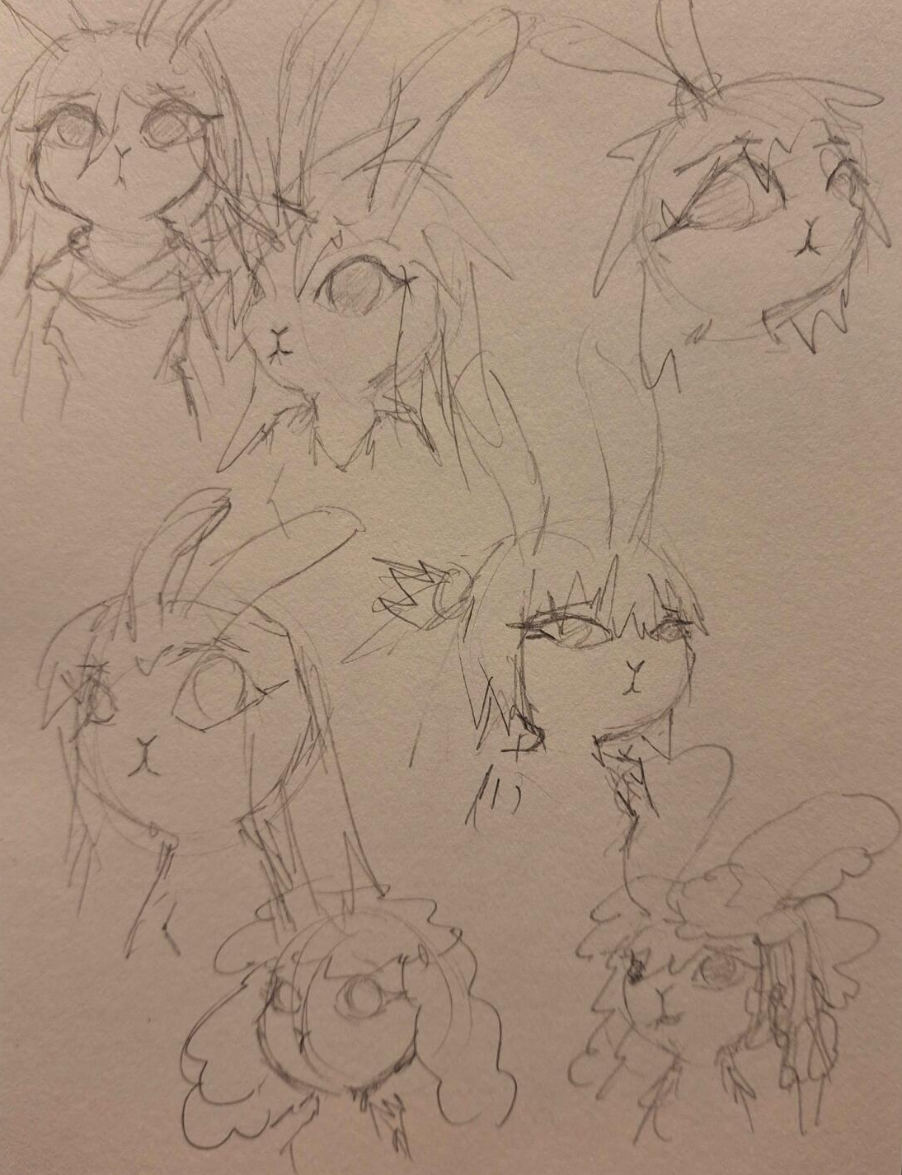
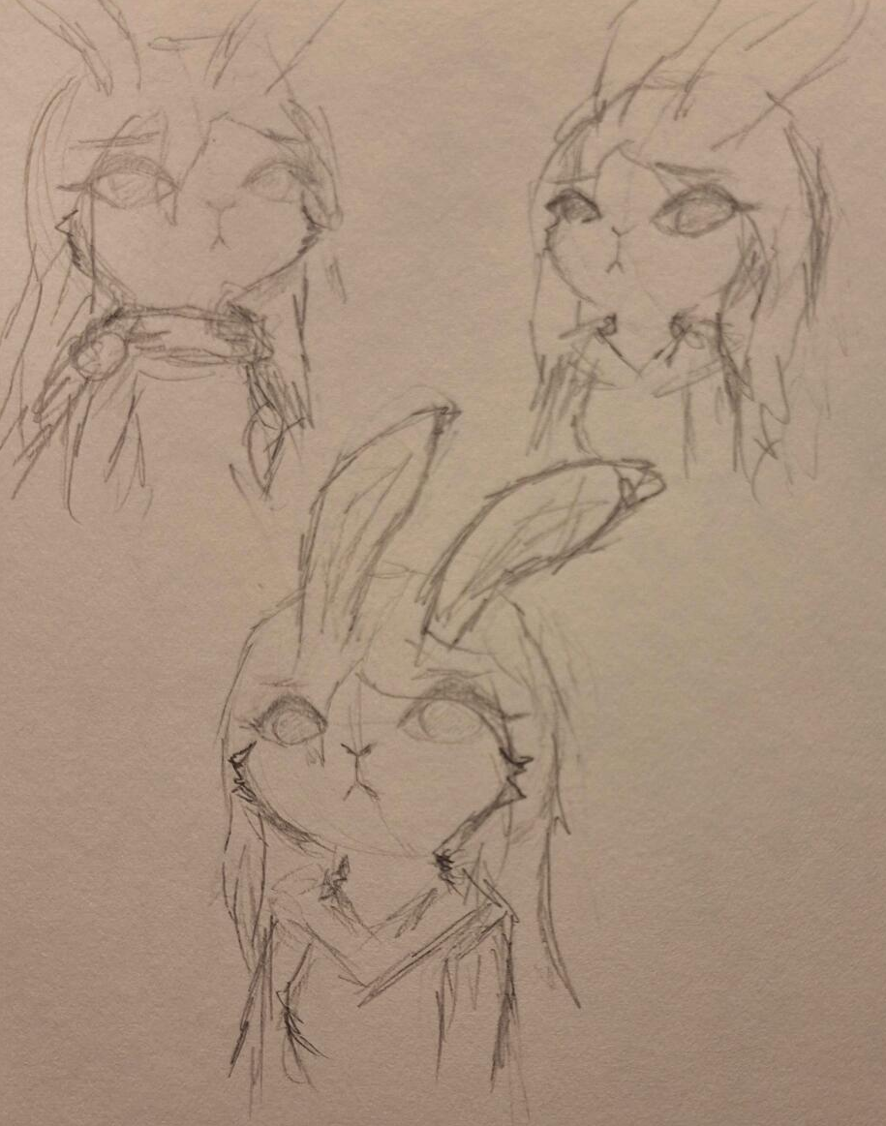
Character - Victim
In her early 20s
Daughter of the CEO of the Snatch company
Well kept and natural beauty
Trust issues (pistanthrophobia)

Slide 7
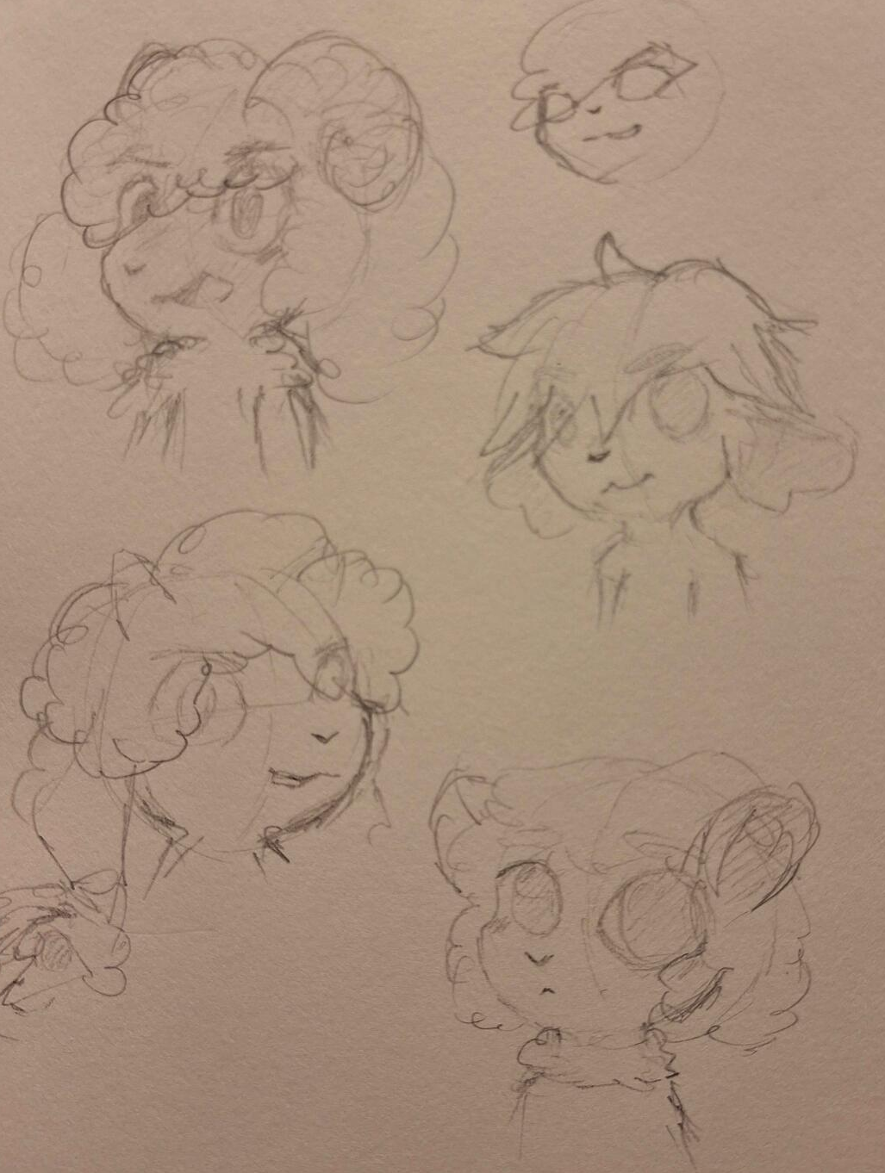
Character - Mastermind
Unknown age
Test subject of Snatch wicked plans
Obscure purpose
Unpredictable and evasive

Slide 8
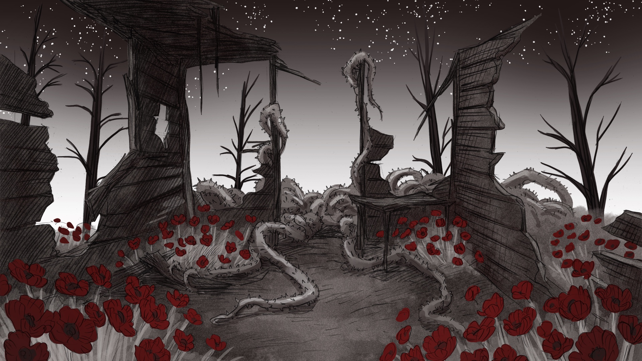

Art and Audio
2D hand drawn in monochromatic colors with deeply colored key details
Musical evolution between mystery/suspense and tragedy/unsettling

Slide 9
Thank you

